Slide 1



IOT & CLOUD MINI PROJECT
KONGU ENGINEERING COLLEGE
PERUNDURAI ERODE-638060
SMART GAS LEAKAGE DETECTION IN HOUSES
TEAM MEMBERS:
RIYA T
SAMVARTHANA G
PRAVEEN B
(20CSR171) (20CSR181)
(20CSR152)
Date : 15/05/2023

Slide 2
OBJECTIVE:
Gas leakage detection systems are essential in ensuring safety in both residential and commercial properties. In this project, we will be using a Node MCU board to create a gas leakage system that detects the presence of gas in the environment and alerts the user.
The system will consist of a gas sensor that detects the gas concentration in the air, and a Node MCU board that reads the data from the sensor. If the concentration of gas exceeds a certain threshold, the Node MCU will trigger an alarm to alert the user. Additionally, the system can be connected to the internet to enable remote monitoring of
gas concentration levels.

Slide 3
REQUIREMENTS:
Breadboard
MQ-2 sensor
Node MCU
Lighter
USB To Type-B Cable
Jumper Wires (Male to Female)

Slide 4
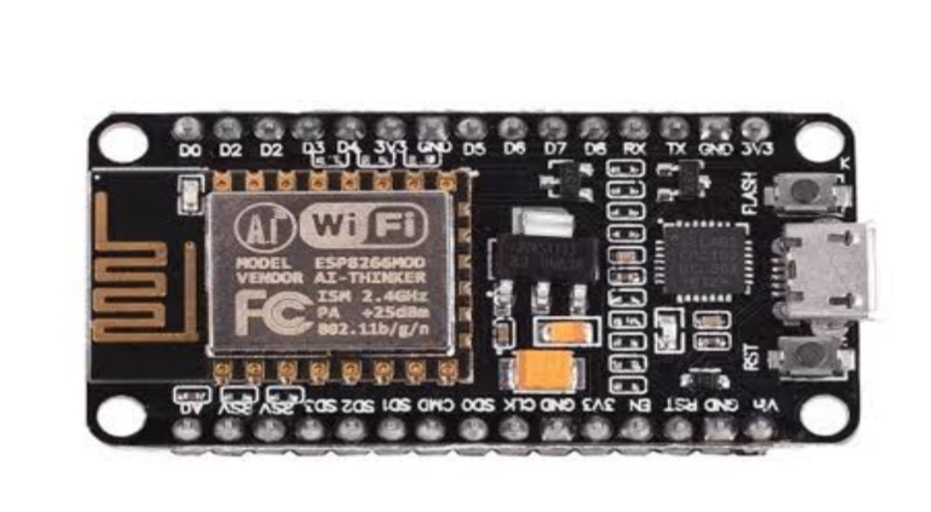
NODE MCU:
NodeMCU is an open-source firmware and development kit that is based on the ESP8266 Wi-Fi SoC (System on a Chip).
It is designed to provide an easy-to-use platform for building IoT applications, including smart home devices, wearables, and remote monitoring systems.
The NodeMCU development kit includes a microcontroller unit (MCU) with integrated Wi-Fi, along with a range of GPIO (General Purpose Input/Output) pins for connecting external sensors and other components.
It also includes a USB interface for programming and power supply.

Slide 5

MQ-2 SENSOR:
The MQ-2 sensor is a gas sensor module that is designed to detect various types of flammable gases, smoke, and other pollutants in the air.
It is commonly used in gas leakage detection systems, smoke detectors, and air quality monitoring devices.
The MQ-2 sensor works by heating a small sensing element and measuring the resistance changes when different gases come into contact with it.

Slide 6
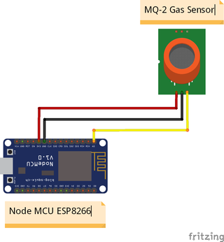
CIRCUIT DIAGRAM:

Slide 7
PROGRAM:
#define BLYNK_TEMPLATE_ID "TMPL2FWjDmBwv"
#define BLYNK_TEMPLATE_NAME "Gas Leakage Alert"
#define BLYNK_AUTH_TOKEN "6XK14D9MsUlxY_6Ogk0ggHB-J__CCVTN"
#define BLYNK_PRINT Serial
#include <ESP8266WiFi.h>
#include <BlynkSimpleEsp8266.h>
char auth[] = BLYNK_AUTH_TOKEN;
char ssid[] = “realmeX2"; // Enter your wifi name
char pass[] = “1234"; // Enter your wifi password
int smokeA0 =A0;
int data = 0;
int sensorThres = 100;
BlynkTimer timer;
void sendSensor(){
int data = analogRead(smokeA0);
Blynk.virtualWrite(V0, data);
Serial.print("Pin A0: ");
Serial.println(data);

Slide 8
if(data > 950) // Change the Trashold value
{
// Blynk.email(“riyat.20cse@kongu.edu", "Alert", "Gas Leakage Detected!");
Blynk.logEvent("gas_alert","Gas Leakage Detected");
}
}
void setup(){
pinMode(smokeA0, INPUT);
Serial.begin(115200);
Blynk.begin(auth, ssid, pass);
//dht.begin();
timer.setInterval(2500L, sendSensor);
}
void loop(){
Blynk.run();
timer.run();
}

Slide 9
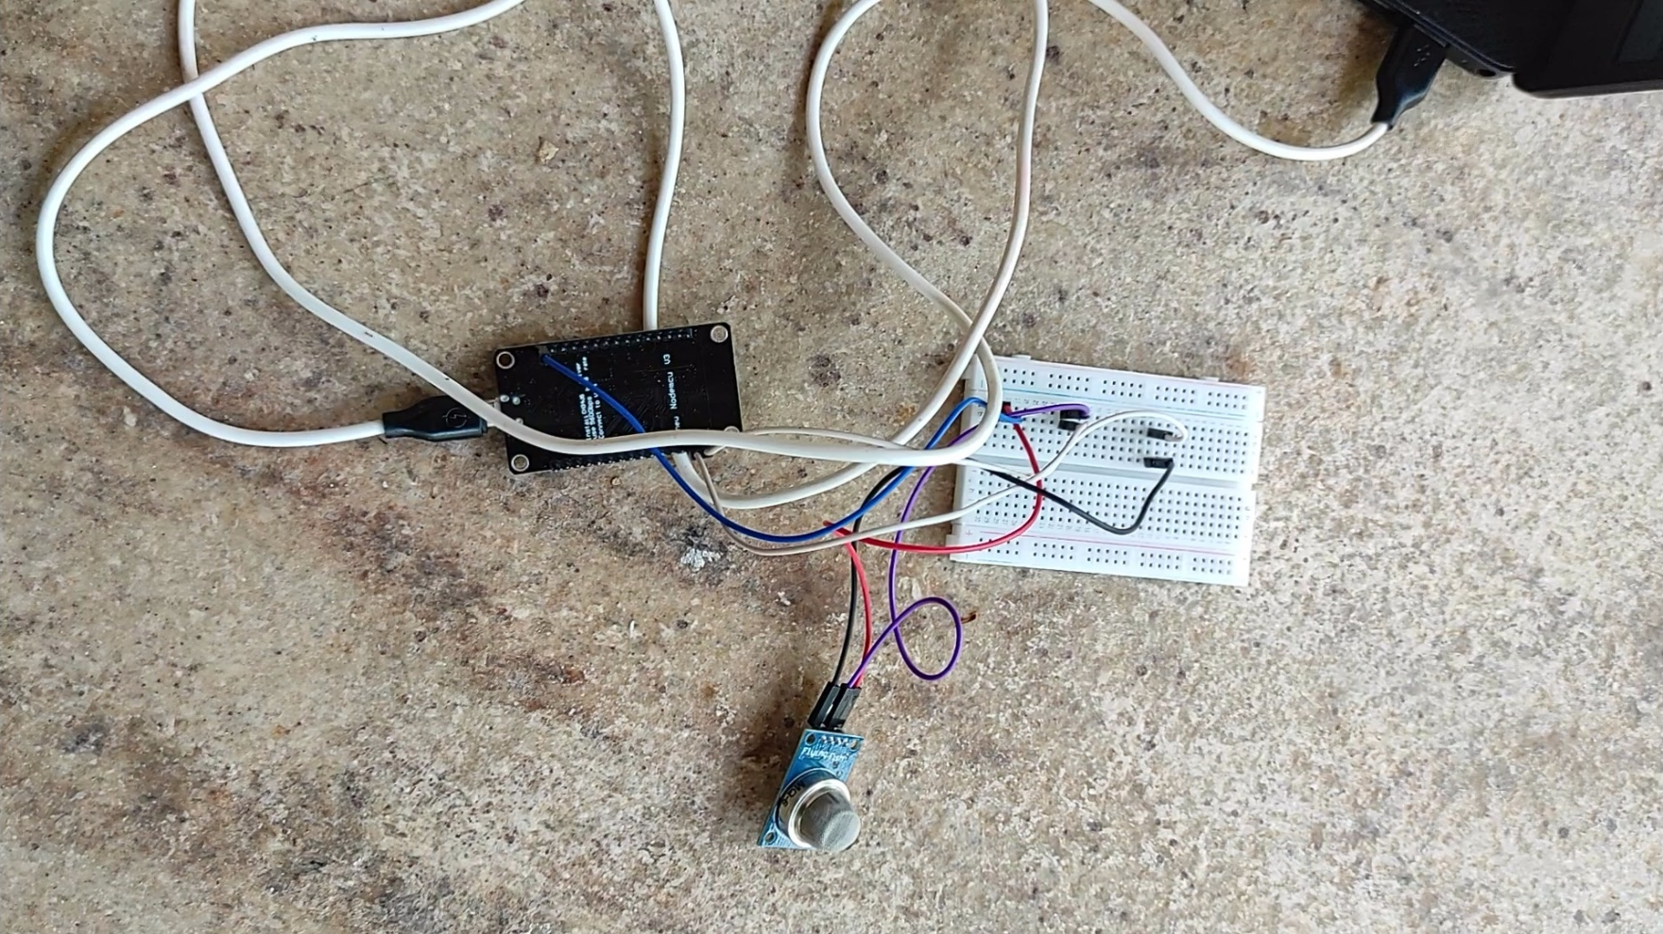
CIRCUIT CONNECTION :

Slide 10
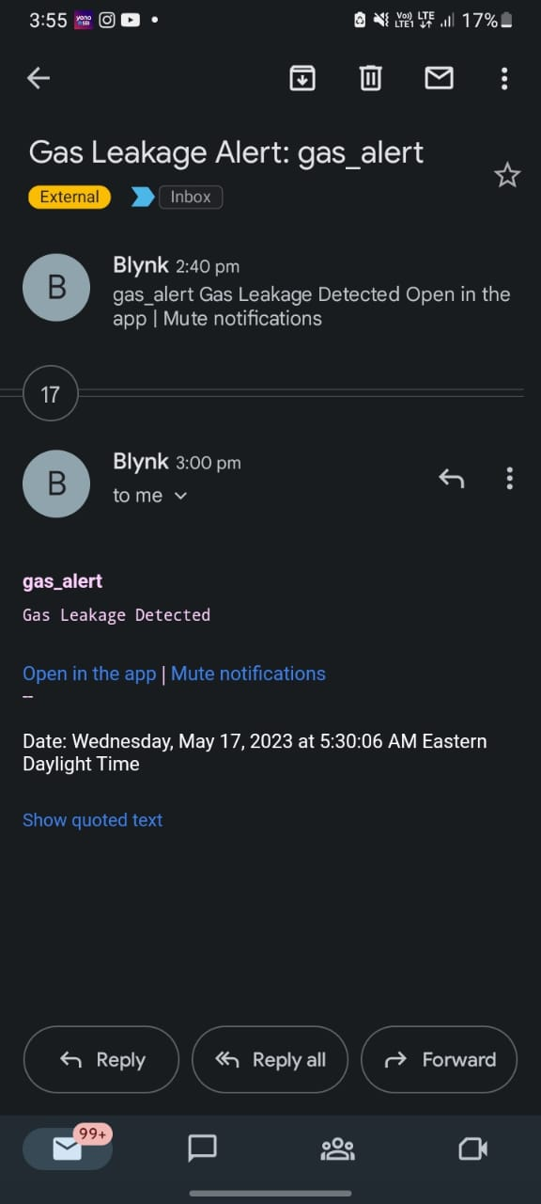
OUTPUT:

Slide 11
Thank You !!

